Slide 1


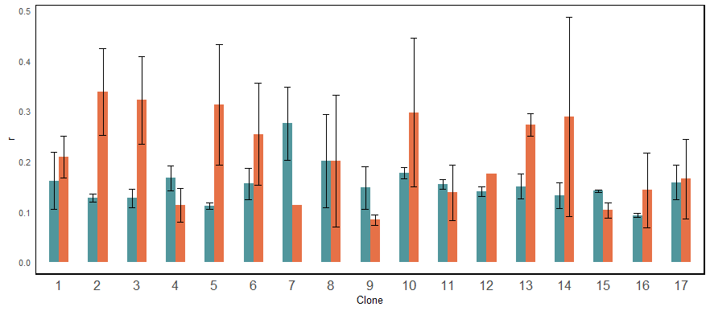
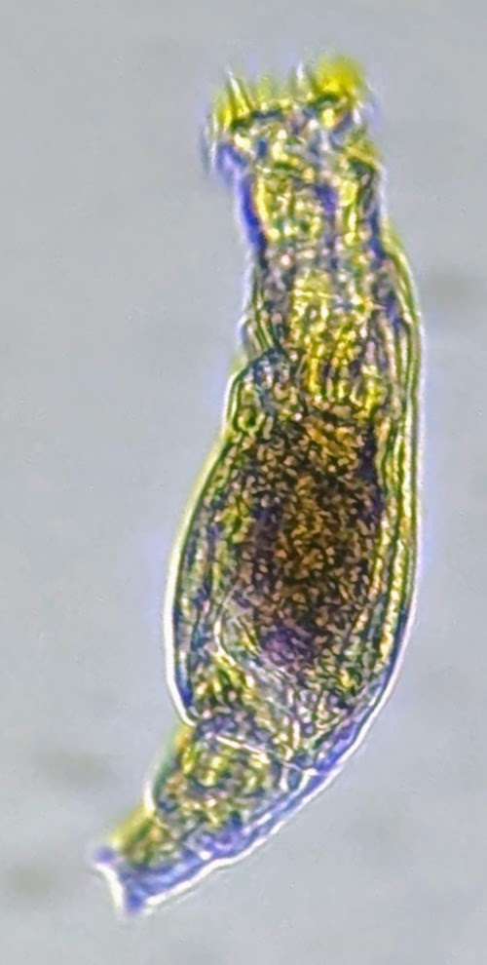
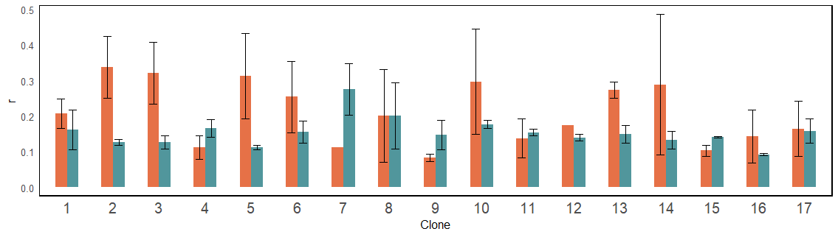
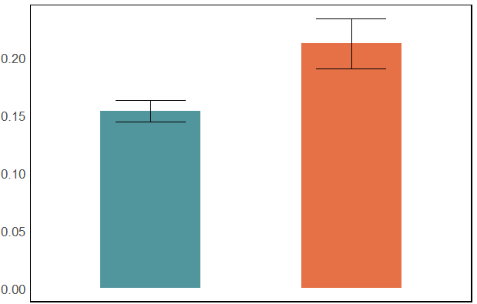
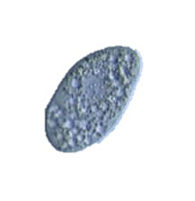
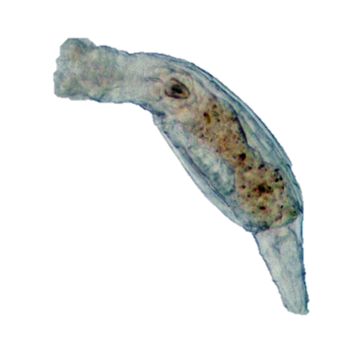
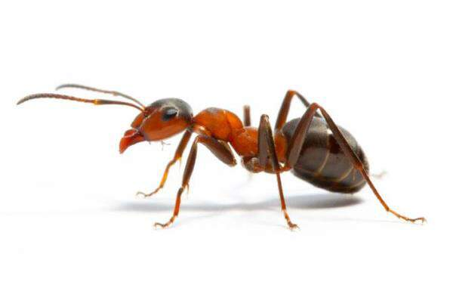
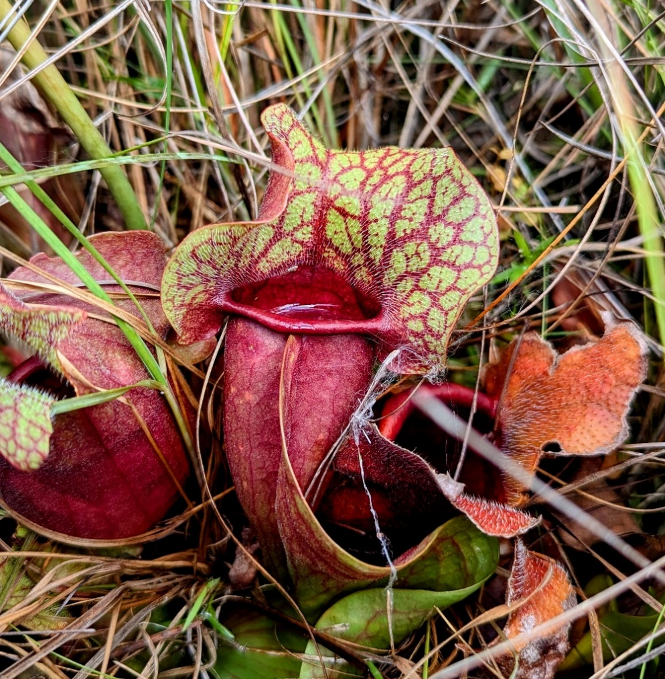
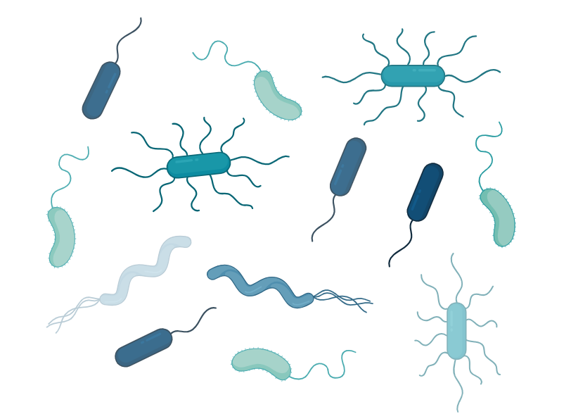
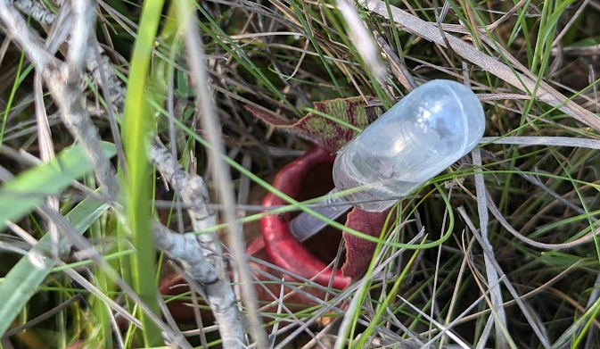
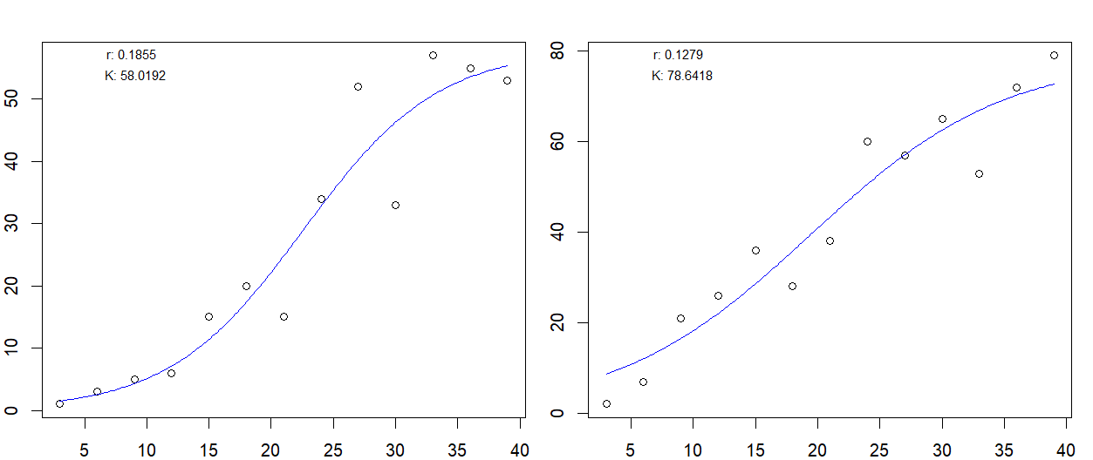
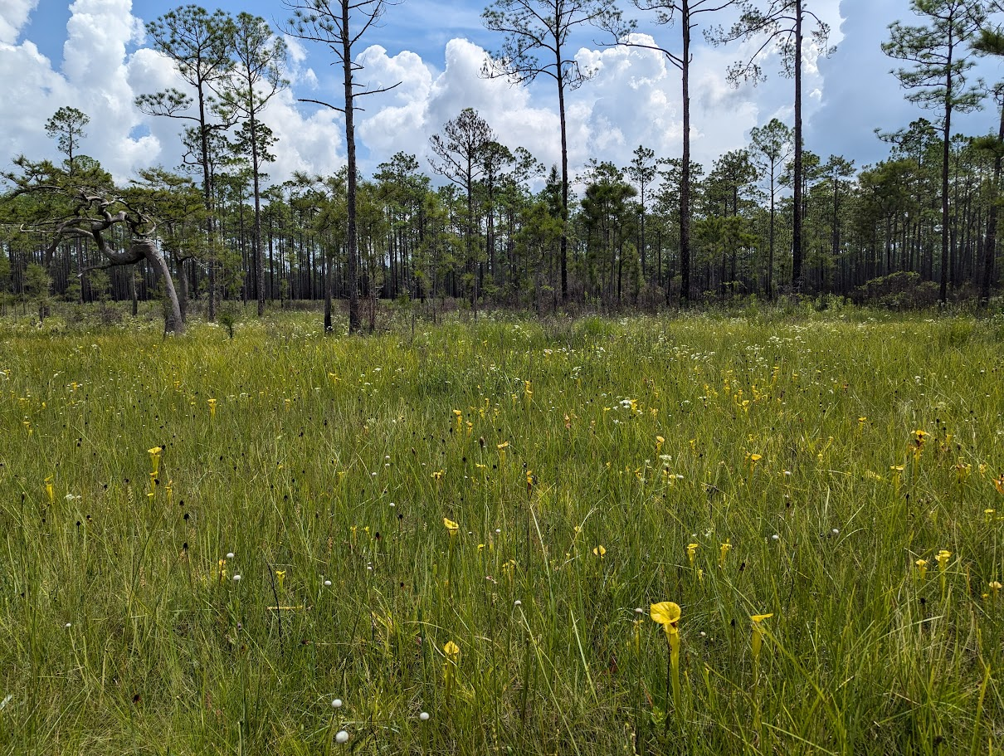
Does response to increased temperature differ among clones of pitcher plant rotifers?
Alex A. Mendelson*, Casey P. terHorst
Department of Biology | California State University, Northridge
Background
Results
Conclusions
When faced with rapid global change, many populations are likely to rely on rapid evolution to avoid extinction.
Response to increased temperature differs among clones
On average, H. rosa grew faster at 30°C when compared to 25°C
The potential for a population to rapidly adapt to new stressful conditions relies on diversity in individual stress response.
*
*
*
25°C
Variance in response to increased temperature among clones:
5 respond with increased r
3 respond with decreased r
9 with no sig. response
30°C
*
Mean ± SE
n = 3
Does response to increased temperature differ among clones of pitcher plant rotifers?
*
Maximum growth rate (r) ± SE
Variation in response unrelated to space
Site contributed <1% of total variance
*
*
*
Habrotrocha rosa:
“Pitcher plant rotifer”
Filter-feeding bacterivore
Obligately parthenogenetic (only reproduce asexually)
Apomixic (offspring are full-clones of their mothers)
Potential for rapid evolution…?
Next Steps
Clone:
Indirect effects of climate change on ecology, mediated by evolution, may play an important roll on the trajectory of natural communities.
Effect:
ns
(+)
(+)
ns
(+)
ns
(-)
ns
(-)
ns
ns
(+)
(+)
ns
(-)
ns
ns
Leaf:
Site:
Pitcher Plant Leaf Community:
Higher growth rate at higher temperature
Climate Change
Species A
Species B
Competition
Evolution
Competition
Average maximum growth
rate (r) ± SE
Maximum growth rate was higher at 30°C across all 17 clones (Type III ANOVA: F_{1,84} = 4.57, p = 0.03)
Site (0.66%), leaf (5.40%), and clone (2.85%) accounted for a non-trivial amount of total variance
Ciliates
Bacterivory
H. rosa
Indirect Effect
An ongoing evolution experiment aims to compare the competitive ability of rotifer populations with different evolutionary histories of temperature.
Basal Resource
Competition
Bacteria
Sarracenia purpurea
25°C
30°C
~50 gen.
~2 gen.
no
yes
30°C
30°C
Mixed-clone Cultures
Contemp. Temp
Methods
25°C
1 Field Collection & Isolation:
3 Data Analysis:
25°C Plasticity Buffer
97 leaf water samples from Sarracenia purpurea in the Apalachicola National Forest, FL
Individuals of H. rosa isolated to establish clonal cultures
Example growth curve:
25°C
30°C
Maximum growth rate (r) was estimated using a logistic model (‘growthrates’, R)
The effect of temperature on growth rate was tested using a linear mixed model with site, leaf, and clone included as random effects
To meet assumptions, growth rate was transformed using a negative inverse square root: -1 / sqrt(rate)
K: 58.02
Contemp. Temp
25°C
r: 0.1855
2 Temperature Response Experiment:
Rotifers in 0.3 ml sample
17 clones grown in constant 25°C and 30°C for 39 d (n = 3)
Clones represent diversity across 2 sites, 3 leaves per site, 3 clones per leaf
0.3 ml sample counted every 3 d
Acknowledgments
Time (d)
Thank you to Dr. Tom Miller, Mark Harris, Dr. Gilberto Flores, and undergrads Vincent Cannizzaro and Breana Morales.
This project was supported by the Thesis Support Grant from the CSUN Office of Graduate Studies.

